Slide 1

Submitted to Professor Nikhil Shah Submitted by Group 6 Members Auradee Castro Bhumika Rajendra Babu Olivia Deguit
Term 1 F22 Project : BDM 1113 NoSQL Database
Spotify Tracks and Artists [2022]
December 10, 2022

Slide 2
CONTENT
Project Overview
Spotify: MongoDB and PyMongo
Program Features
Search for Artists or Tracks
View Reports
Refresh Artists and Tracks
Deactivate/Activate Artists Profile
Delete All Artists Profiles
Exit Application

Slide 3
Project Overview
This project is about retrieval of first 1000 tracks and the corresponding artists from Spotify for year 2022. Data extracted from Spotify are stored in MongoDB, which is used for performing Search, Update and Delete Artist Profiles via PyMongo.
Features of the program include the following:
Search for Artists or Tracks
Search for Artists (by Name)
Search for Artists (by Genre)
Search for Artists (by Track Name)
List Deactivated Artists Profile
View Reports
Top 10 Artists with Most Number of Followers
Top 10 Artists with Highest Popularity Index
Top 10 Tracks with Highest Popularity Index
Number of Artists by Popularity Index (80 to 100)
Number of Tracks by Popularity Index (80 to 100)
Refresh Artists and Tracks
Deactivate/Activate Artists Profile
Delete All Artists Profiles
Exit Application

Slide 4
Project Overview
List of files to run the program and the short description
Filename | Description
spotifyApp.py | Main program of the application
dbconnect.py | All functions related to MongoDB connection
spotifyconnect.py | All functions related to Spotify connection
visualization.py | All functions related to graph creation
dbconfig | File containing database configuration

Slide 5
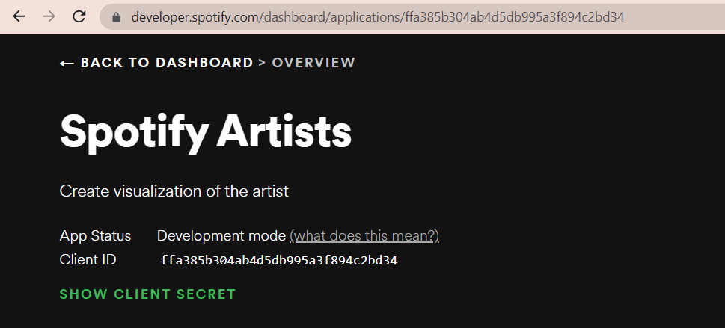

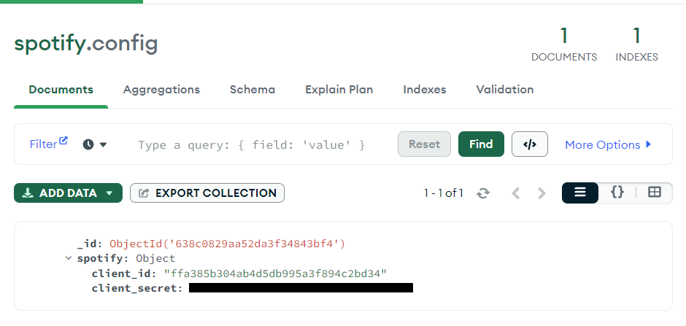
Tech Stack
Spotipy, a lightweight Python library, is used to connect to Spotify Web API. Client ID and client secret is necessary for Spotify connection and data extraction. The credentials are stored in MongoDB.
Instructions to connect to Spotify
Spotify Web API

Slide 6
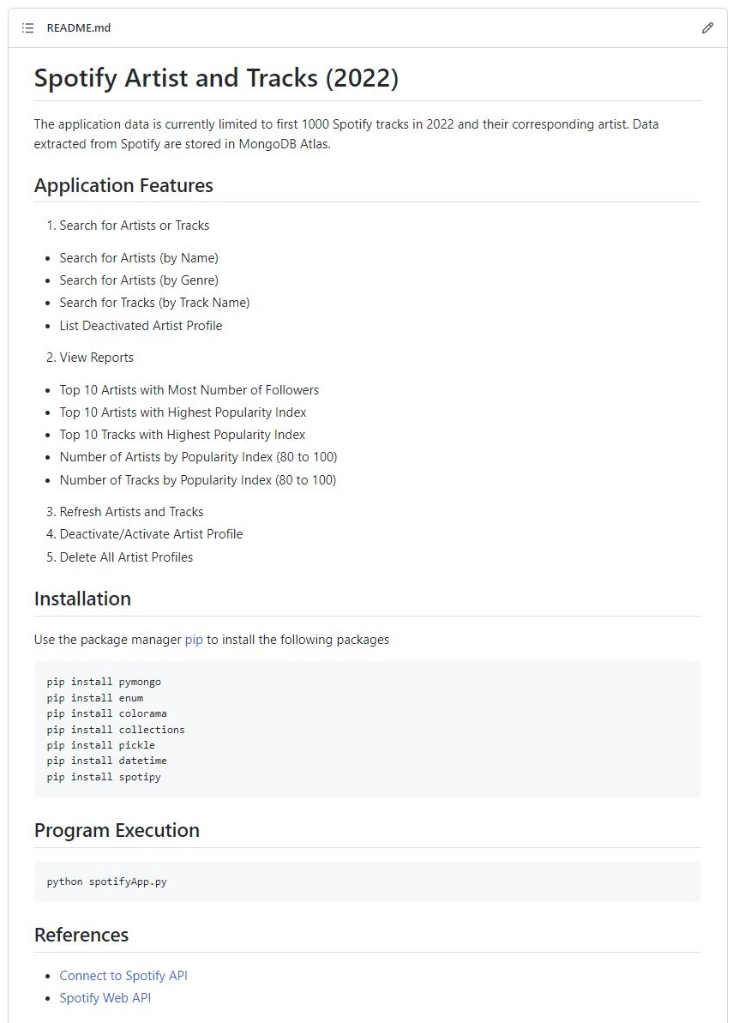

Tech Stack
Application codes can be accessed in Git Hub, including the instructions on package installation and program execution.
Link: https://github.com/abccastro/dsmm.bdm1113

Slide 7


Tech Stack
Numpy and Matplotlib, libraries for Python programming language, are used to create data visualization for the following reports
Top 10 Artists with Most Number of Followers
Top 10 Artists with Highest Popularity Index
Top 10 Tracks with Highest Popularity Index
Number of Artists by Popularity Index (80 to 100)
Number of Tracks by Popularity Index (80 to 100)

Slide 8
CONTENT
Project Overview
Spotify : MongoDB and PyMongo
Program Features
Search for Artists or Tracks
View Reports
Refresh Artists and Tracks
Deactivate/Activate Artists Profile
Delete All Artists Profiles
Exit Application

Slide 9
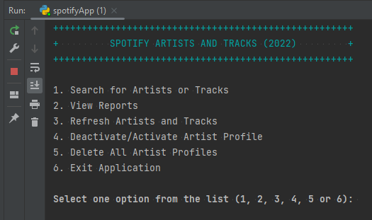
Search for Artists or Tracks (1/12)
Spotify Artists and Tracks (2022) Menu Option is launched upon running spotifyApp.py

Slide 10
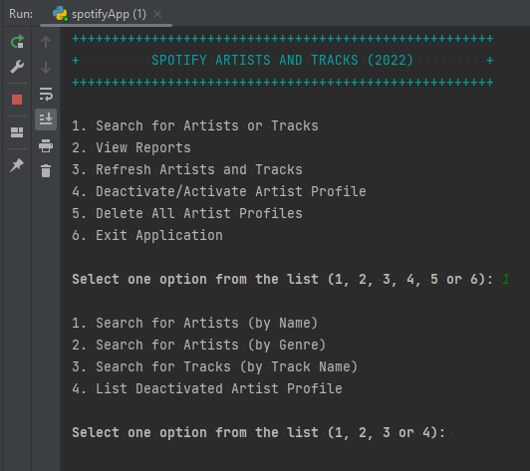
Search for Artists or Tracks (2/12)
User enters “1” as option and the “Search for Artists or Tracks” is launched with another level of sub-category Search Criteria

Slide 11
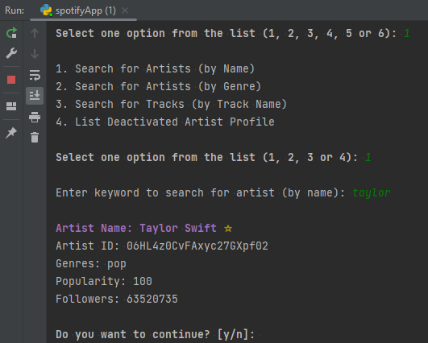
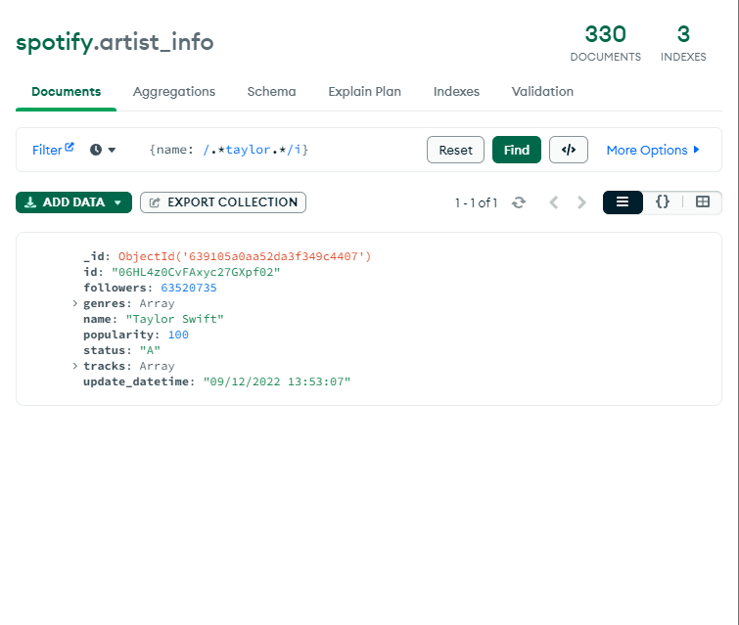
Search for Artists or Tracks (3/12)
User enters “1” to launch “Search for Artists (by Name)” feature
Enter “taylor” as search criteria then hit enter. List of artists with keyword “taylor” is displayed.
Note: Artists with ☆ beside the name means that their popularity is greater than or equal to 80

Slide 12
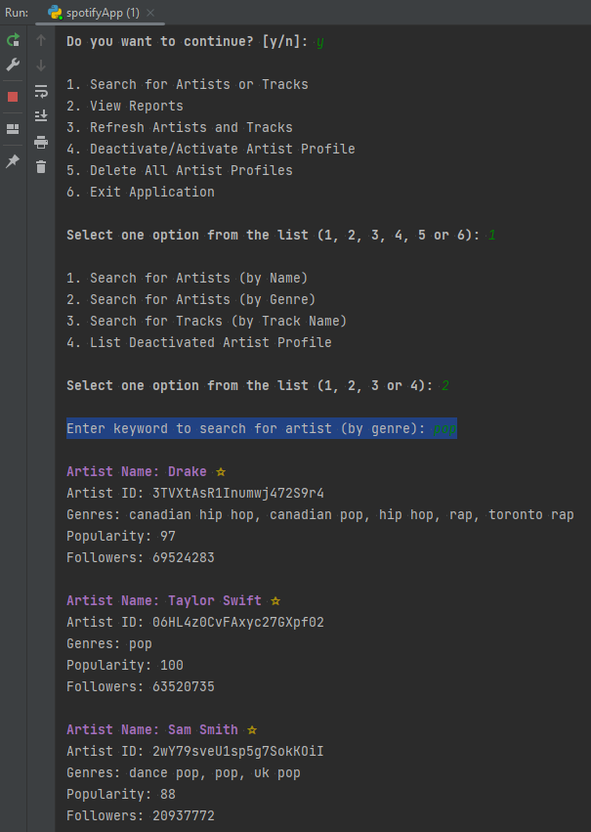
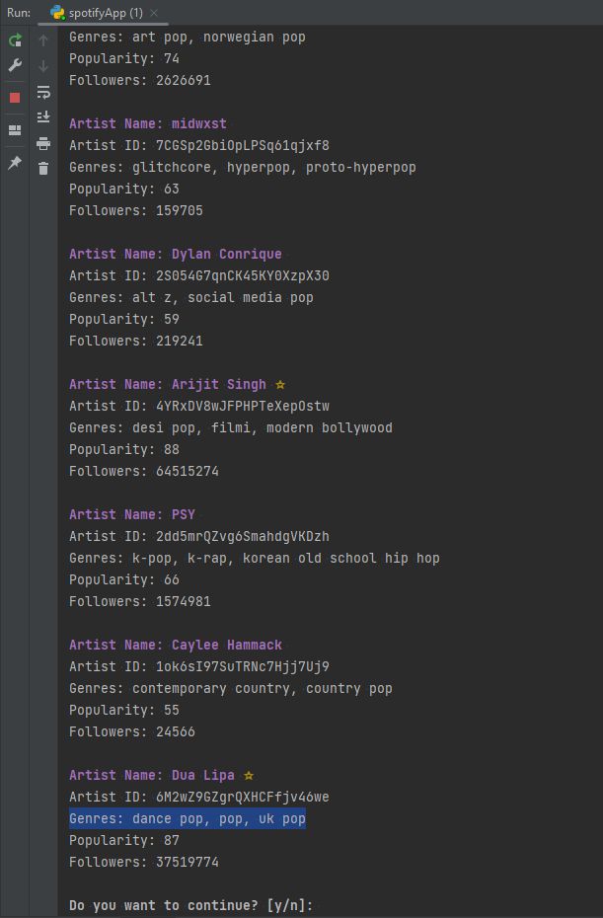
Search for Artists or Tracks (4/12)
User enters “y” then “1” then “2” to launch “Search for Artists (by Genre)” feature
Enter “pop” as search criteria then hit enter. List of artists with keyword “pop” in genres is displayed.

Slide 13
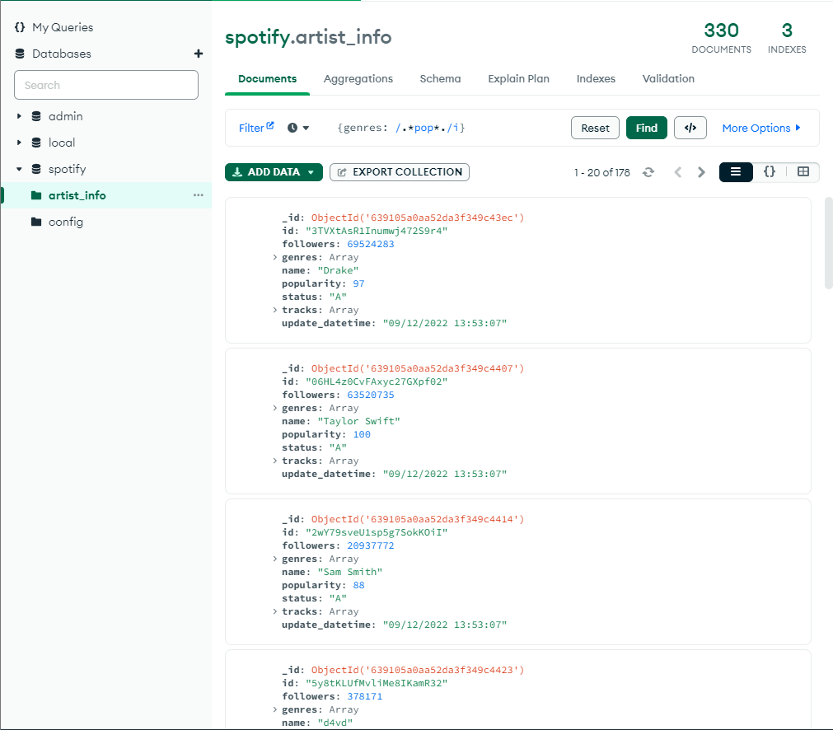
Search for Artists or Tracks (5/12)
Search results in MongoDB with keyword “pop” in artist’s genres

Slide 14
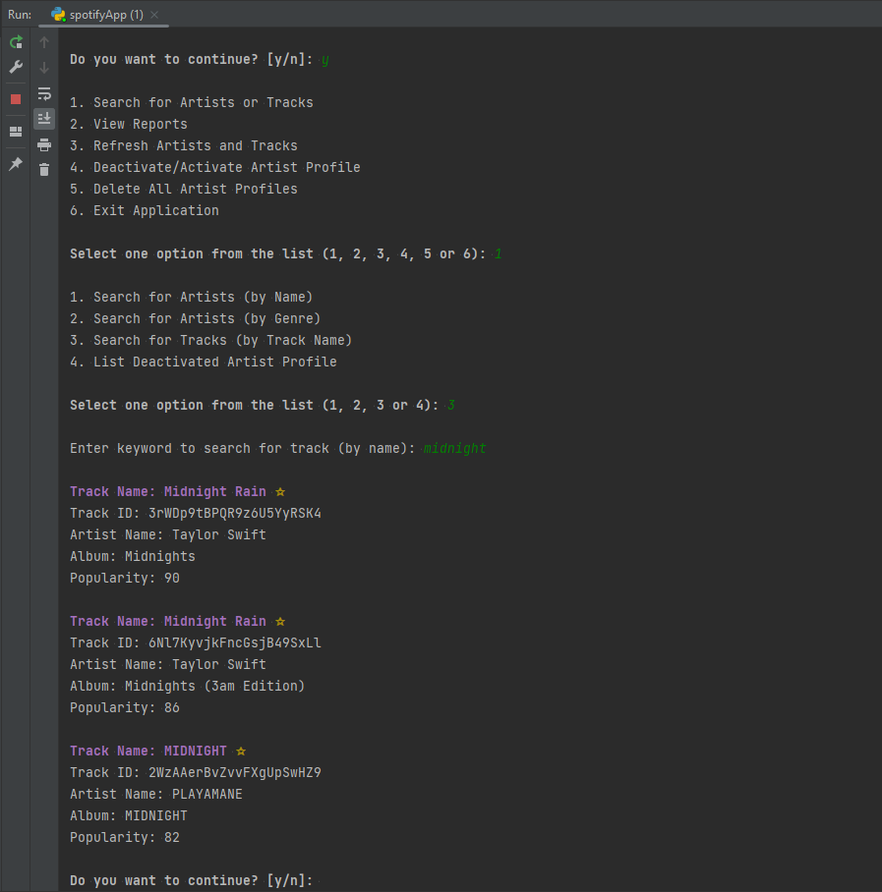
Search for Artists or Tracks (6/12)
User enters “y” then “1” then “3” to launch “Search for Tracks (by Track Name)” feature
Enter “midnight” as search criteria then hit enter. List of tracks with keyword “midnight” is displayed.
Note: Artist tracks with ☆ beside the name means that their popularity is greater than or equal to 80

Slide 15
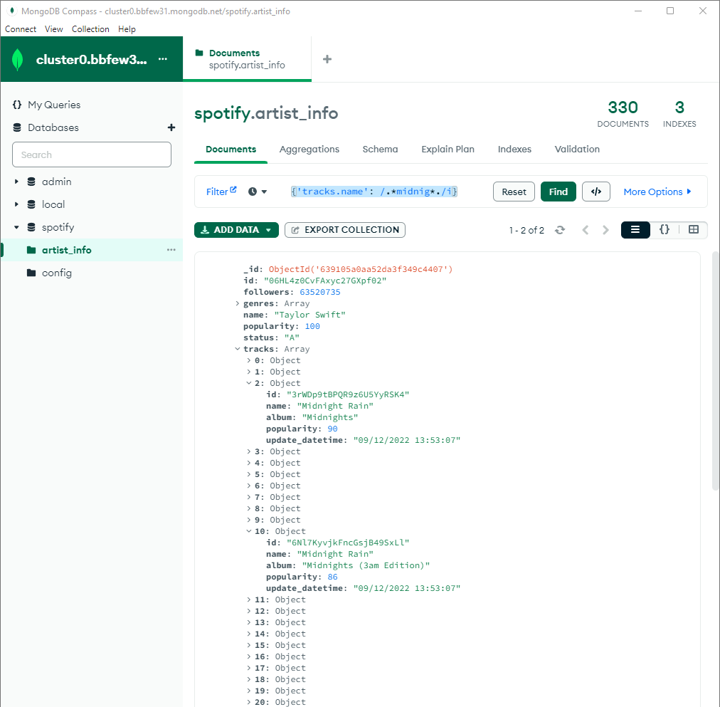
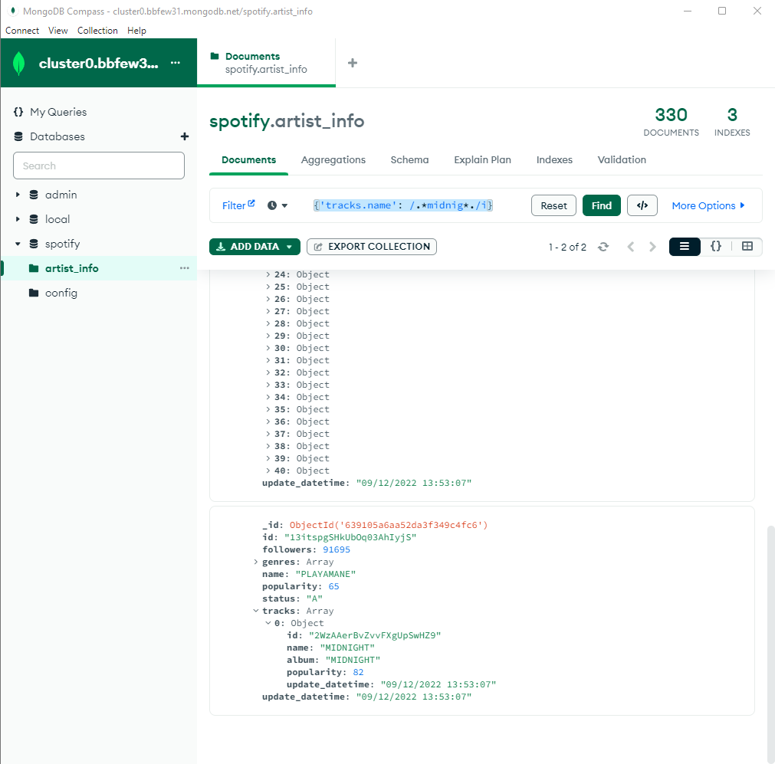
Search for Artists or Tracks (7/12)
Search results in MongoDB with keyword “midnight” in track name

Slide 16
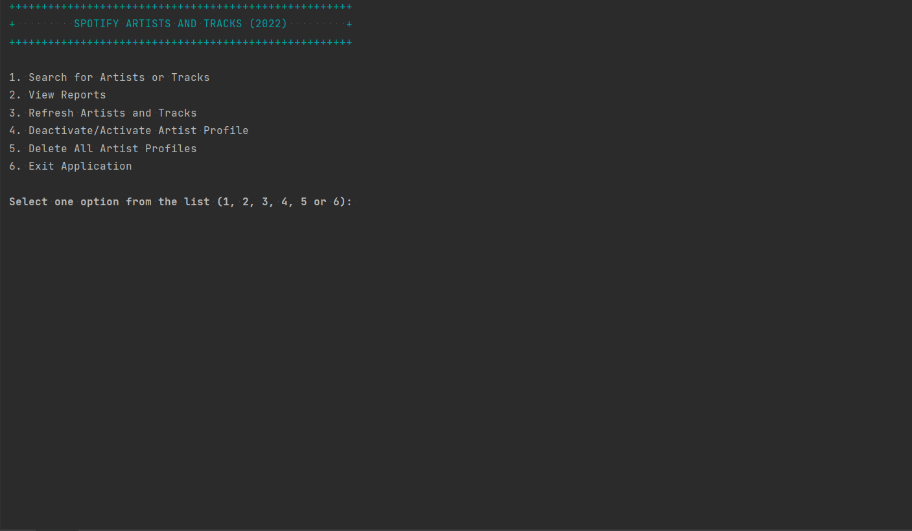
Search for Artists or Tracks (8/12)

Slide 17
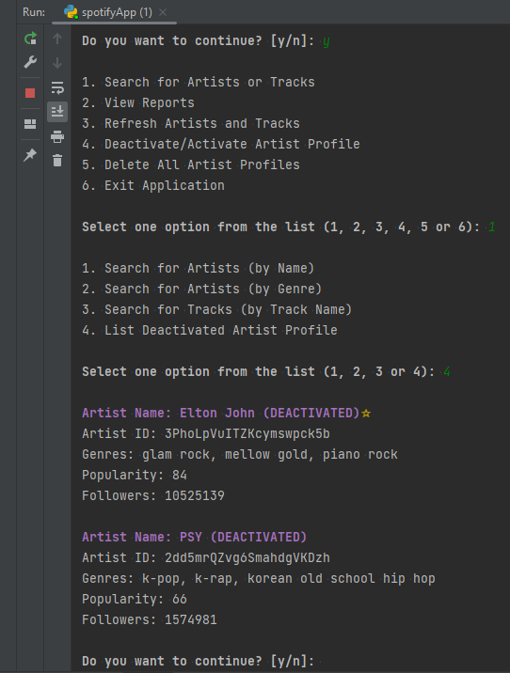
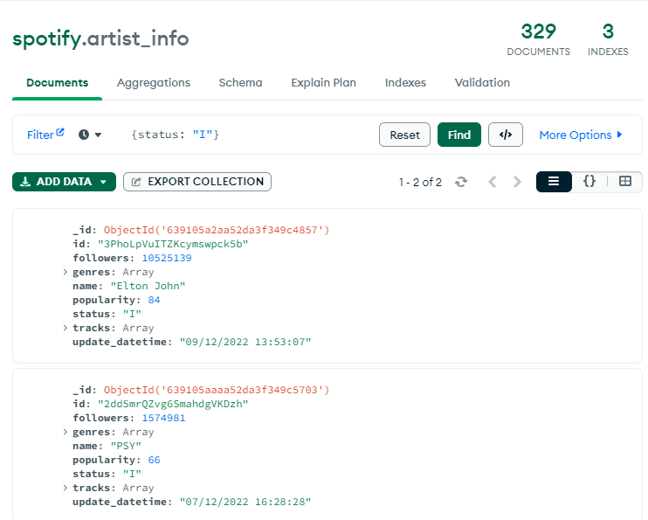
Search for Artists or Tracks (9/12)
User enters “y” then “1” then “4” to launch “List Deactivated Artist Profile” feature
Result when record/s found

Slide 18
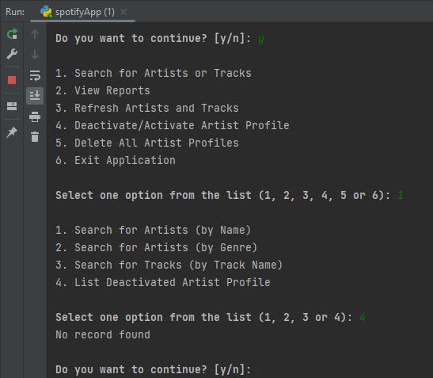
Search for Artists or Tracks (10/12)
User enters “y” then “1” then “4” to launch “List Deactivated Artist Profile” feature
Result when no record found

Slide 19
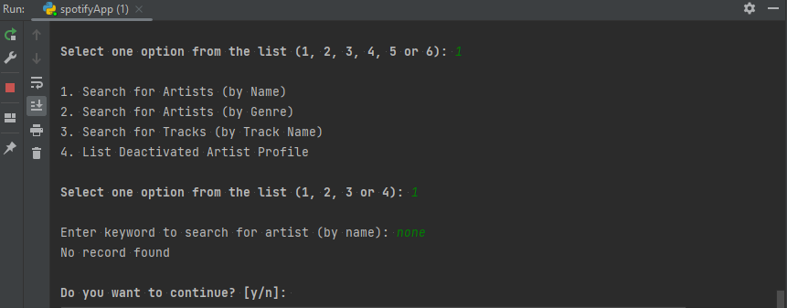

Search for Artists or Tracks (11/12)
Other Error Handling for “Search for Artists or Tracks” feature
No Record found for search for “Artist by Name”
No Record found for search for “Artist by Genre”

Slide 20
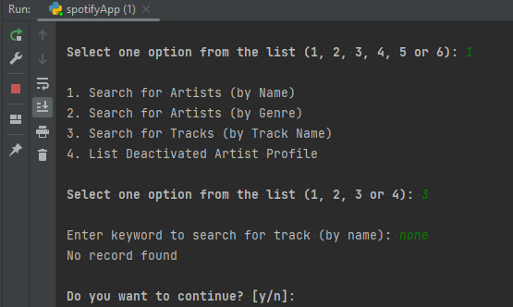
Search for Artists or Tracks (12/12)
Other Error Handling for “Search for Artists or Tracks” feature
No Record found for search for “Artist by Track Name”
No Record found for search for “Deactivated Artist Profile”

Slide 21
CONTENT
Project Overview
Spotify : MongoDB and PyMongo
Program Features
Search for Artists or Tracks
View Reports
Refresh Artists and Tracks
Deactivate/Activate Artists Profile
Delete All Artists Profiles
Exit Application

Slide 22
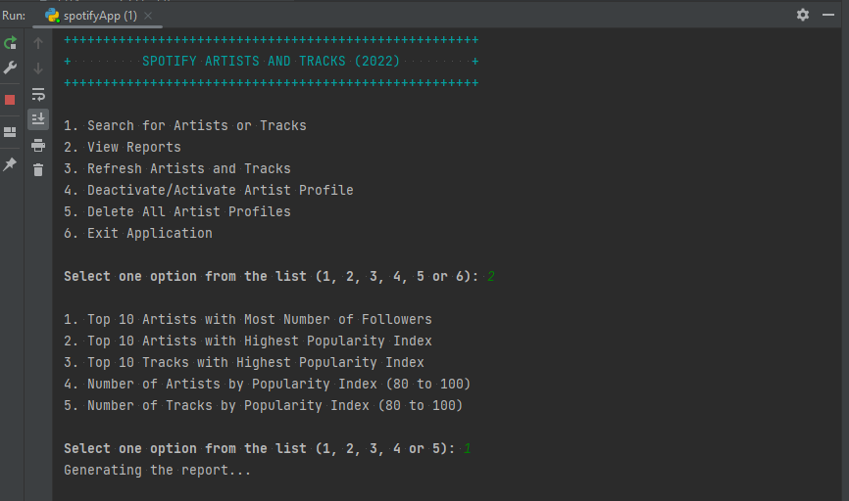
View Reports (1/15)
User enters “2” as option and the “View Reports” feature is launched with another level of sub-category Search Criteria
User enters “1” to launch “Top 10 Artists with Most Number of Followers” report.

Slide 23
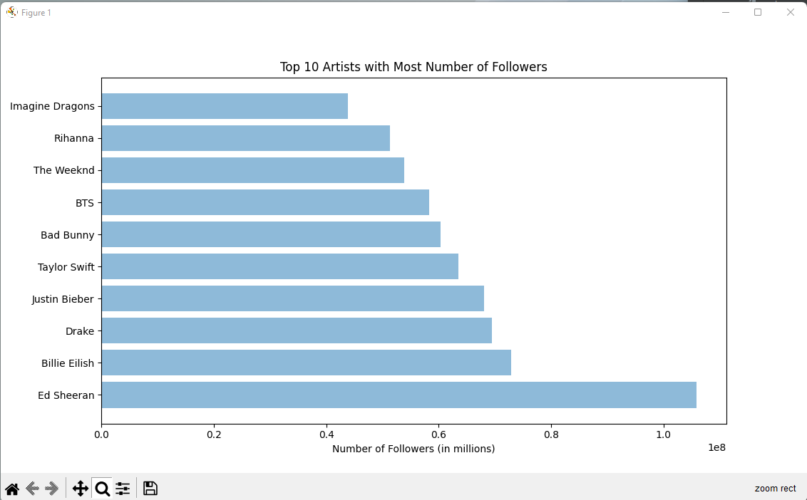
View Reports (2/15)
Report generated for the “Top 10 Artists with Most Number of Followers”

Slide 24
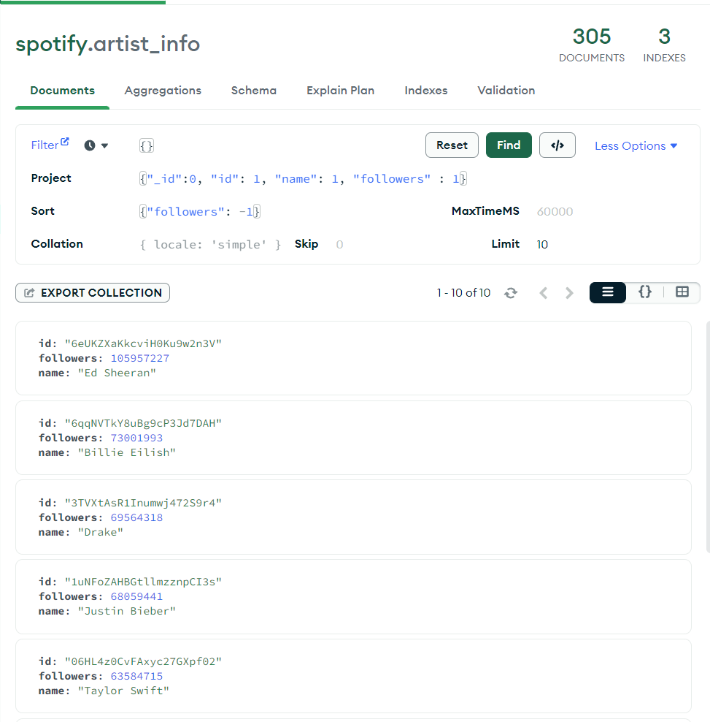
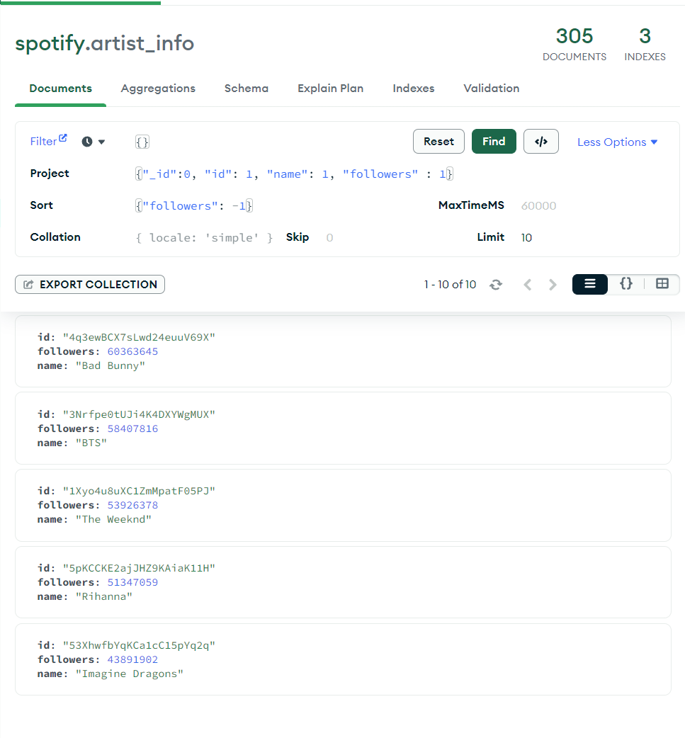
View Reports (3/15)
Search results in MongoDB: “Top 10 Artists with Most Number of Followers”

Slide 25
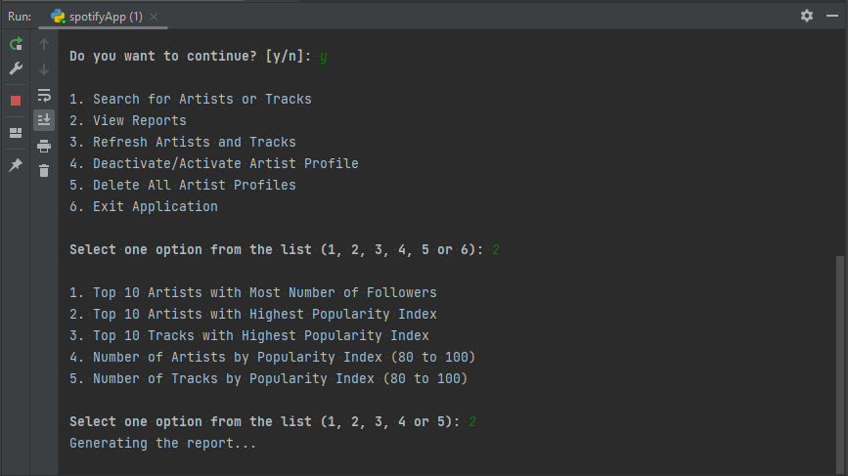
View Reports (4/15)
User closes the report, enters “y” then “2” to launch “View Reports” feature.
User enters “2” to launch “Top 10 Artists with Highest Popularity Index” report.

Slide 26
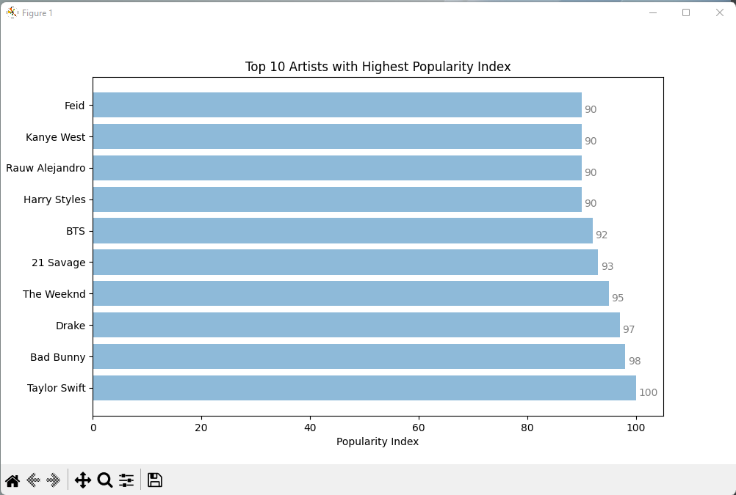
View Reports (5/15)
Report generated for the “Top 10 Artists with Highest Popularity Index”

Slide 27
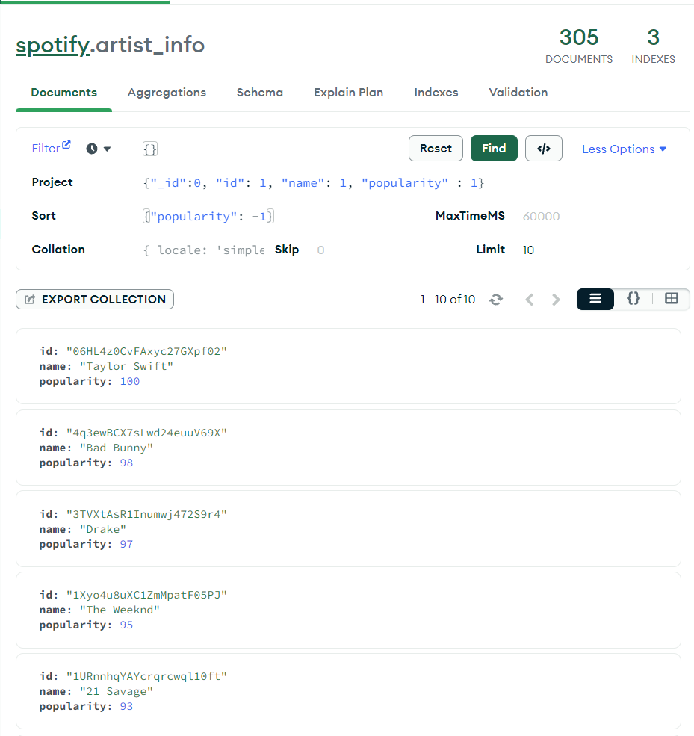
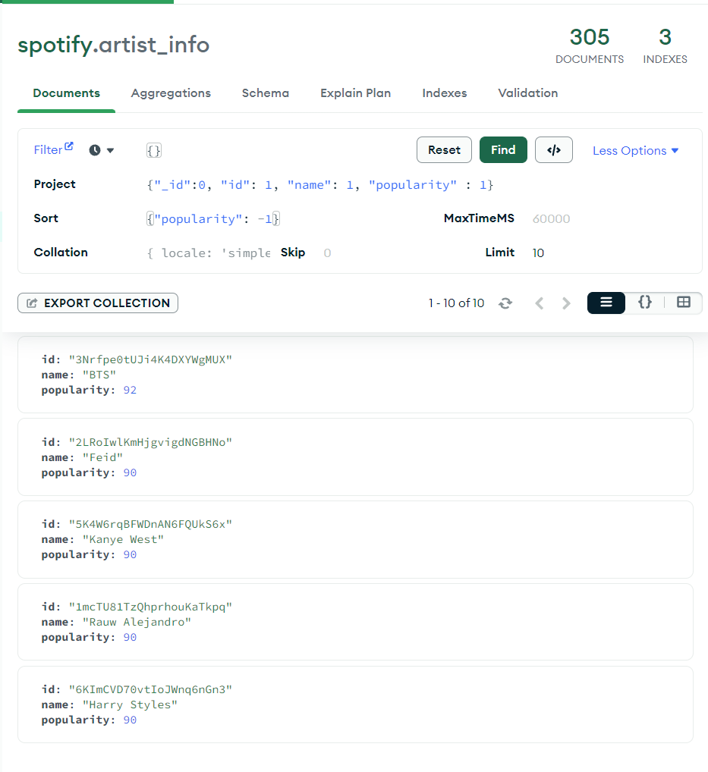
View Reports (6/15)
Search results in MongoDB : “Top 10 Artists with Highest Popularity Index”

Slide 28
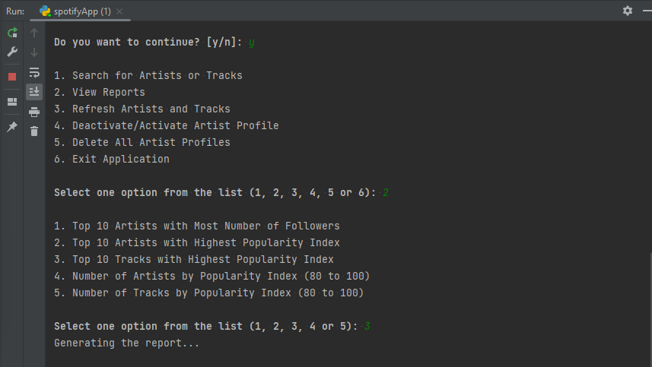
View Reports (7/15)
User closes the report, enters “y” then “2” to launch “View Reports” feature.
User enters “3” to launch “Top 10 Tracks with Highest Popularity Index” report.

Slide 29
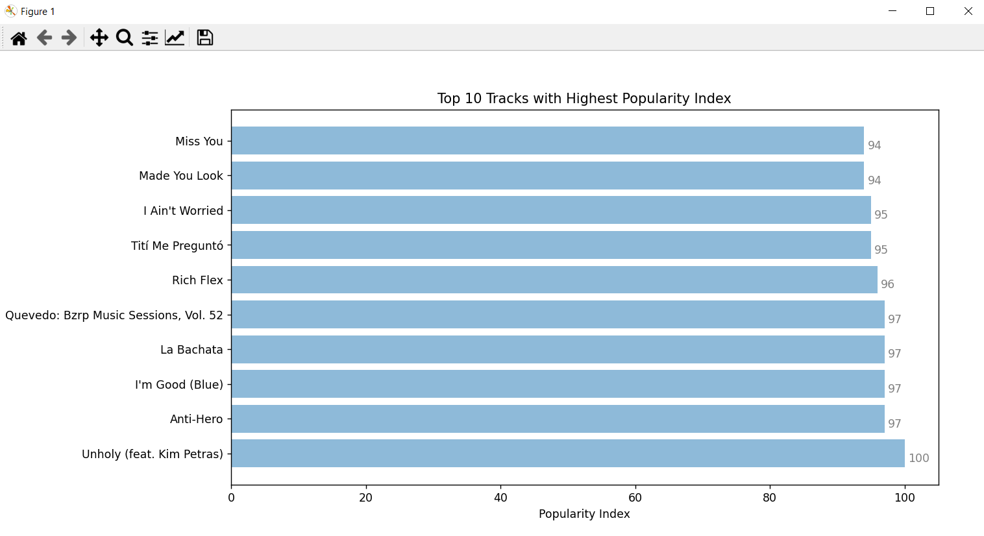
View Reports (8/15)
Report generated for the “Top 10 Tracks with Highest Popularity Index”

Slide 30
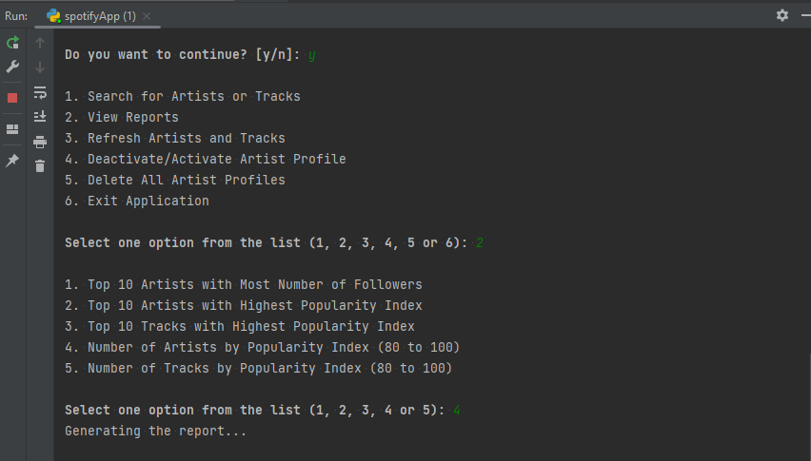
View Reports (9/15)
User closes the report, enters “y” then “2” to launch “View Reports” feature.
User enters “4” to launch “Number of Artists by Popularity Index (80 to 100)” report.

Slide 31
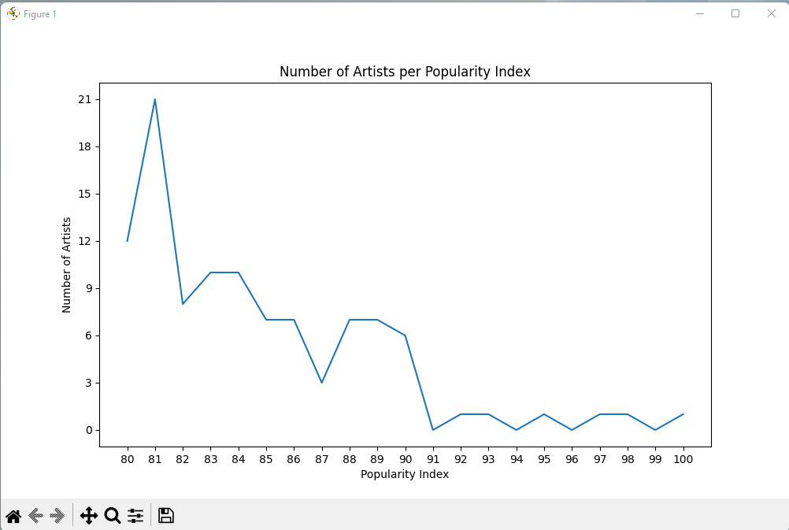
View Reports (10/15)
Report generated for the “Number of Artists by Popularity Index (80 to 100)”

Slide 32
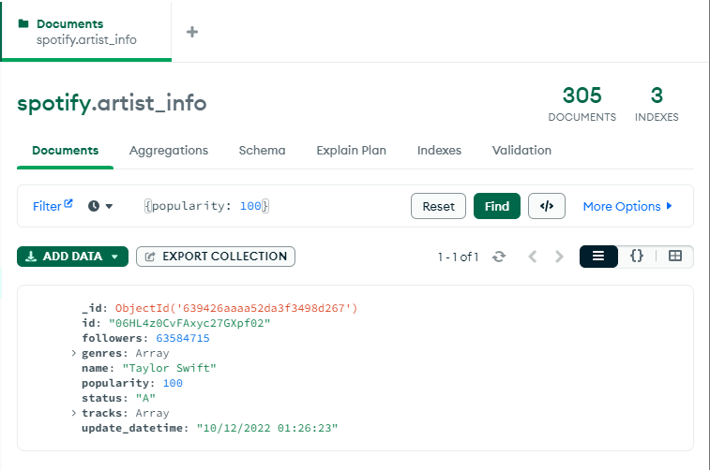
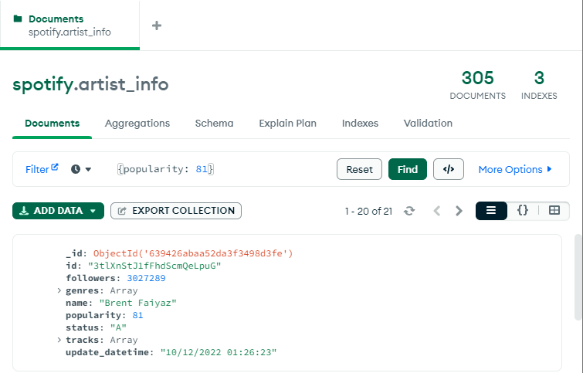
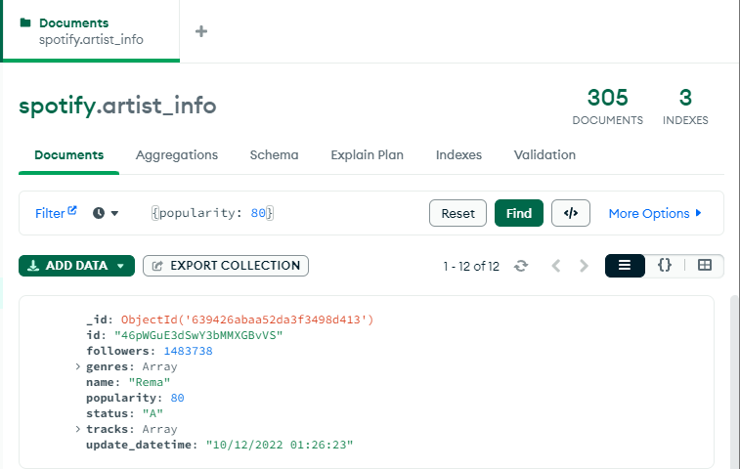






View Reports (11/15)
Search results in MongoDB : “Number of Artists by Popularity Index (80 to 100)”

Slide 33
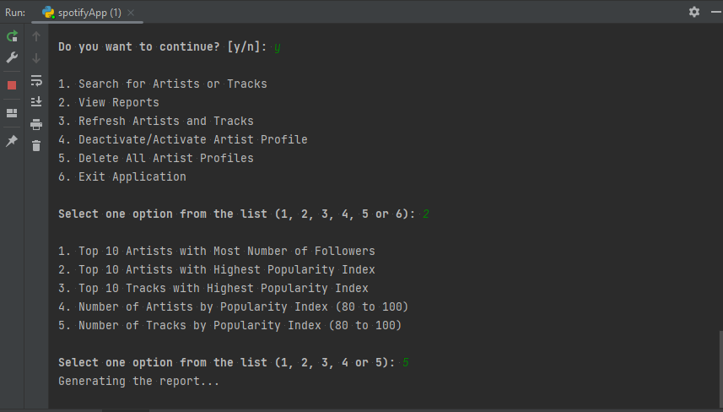
View Reports (12/15)
User closes the report, enters “y” then “2” to launch “View Reports” feature.
User enters “5” to launch “Number of Tracks by Popularity Index (80 to 100)” report.

Slide 34
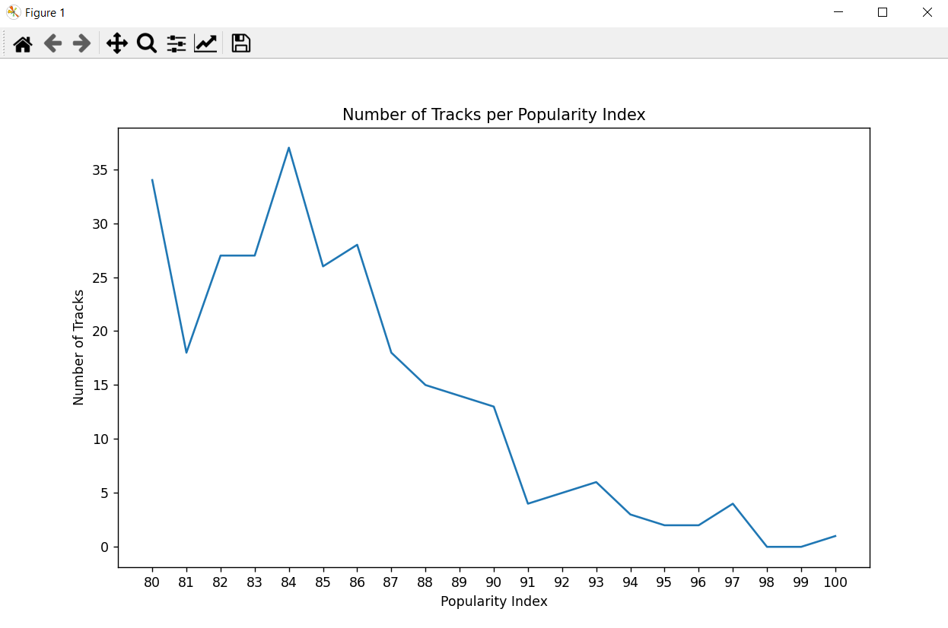
View Reports (13/15)
Report generated for the “Number of Tracks by Popularity Index (80 to 100)”

Slide 35
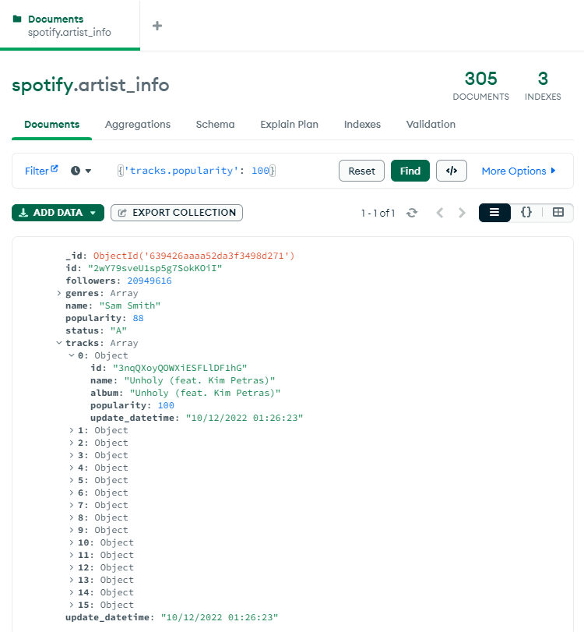
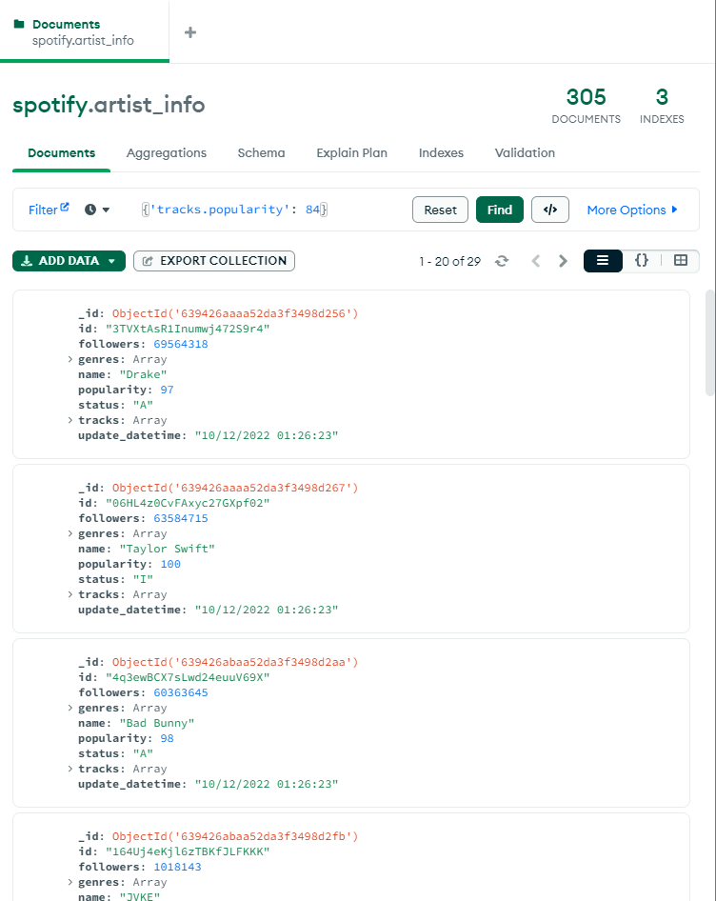





View Reports (14/15)
Search results in MongoDB : “Number of Tracks by Popularity Index (80 to 100)”
.

Slide 36
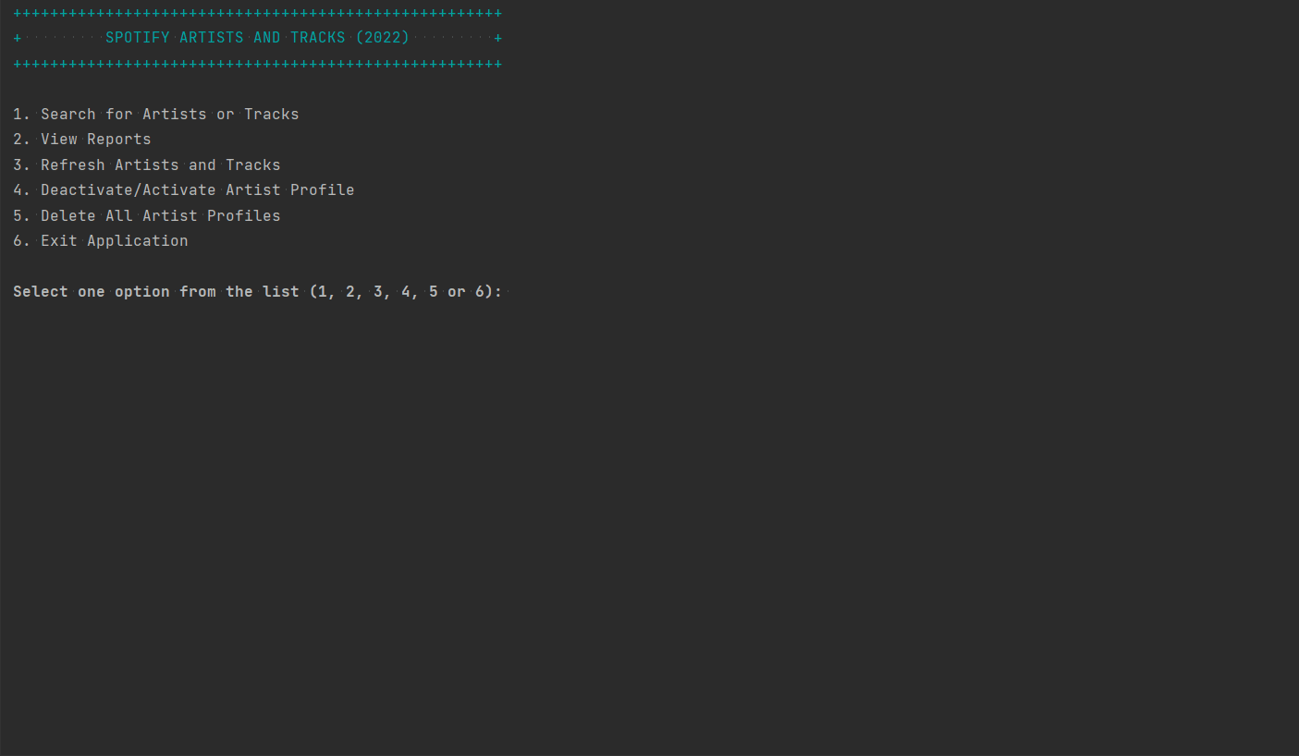
View Reports (15/15)

Slide 37
CONTENT
Project Overview
Spotify : MongoDB and PyMongo
Program Features
Search for Artists or Tracks
View Reports
Refresh Artists and Tracks
Deactivate/Activate Artists Profile
Delete All Artists Profiles
Exit Application

Slide 38
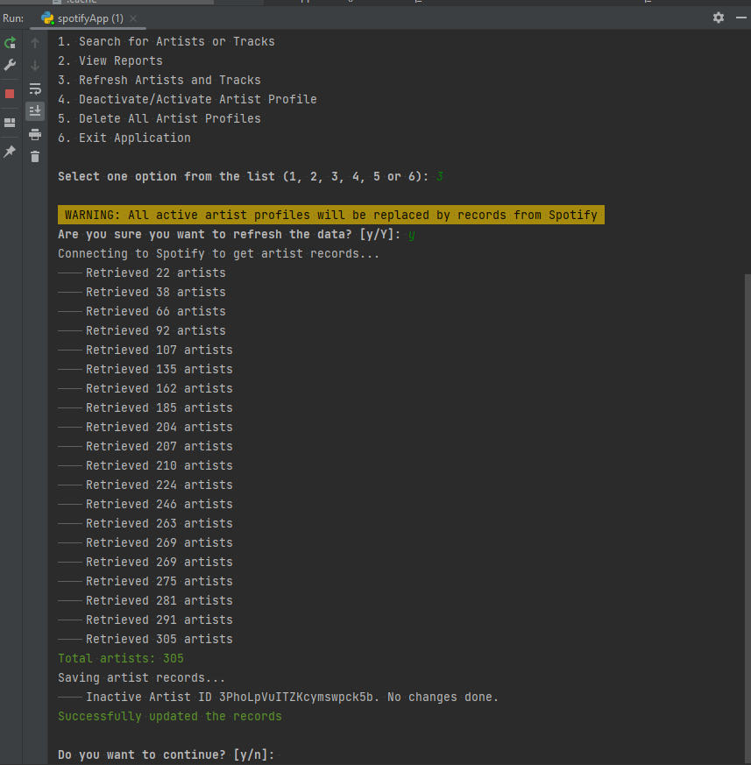
Refresh Artist and Tracks (1/3)
User enters “3” as option and the user is prompted if he would like to proceed with replacing the active artist profiles with records from Spotify.
User enters “y” to launch to proceed with data refresh from Spotify records.

Slide 39
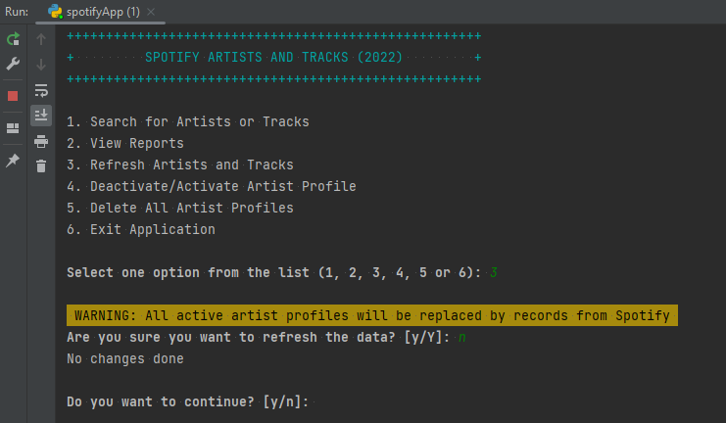
Refresh Artist and Tracks (2/3)
User enters “y” then “3” as option and the user is asked if he would like to proceed with replacing the active artist profiles with records from Spotify.
User enters “n” to keep the current records in MongoDB

Slide 40
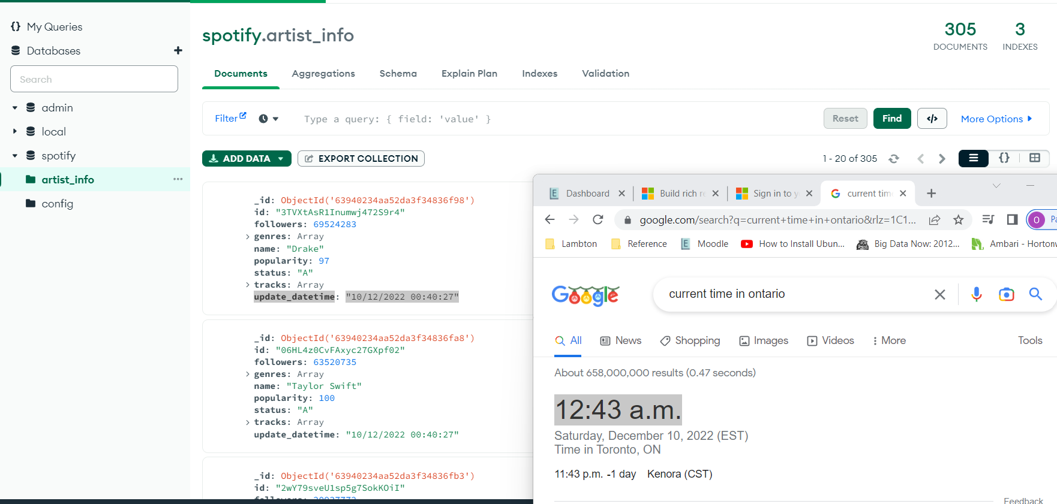
Refresh Artist and Tracks (3/3)
Post validation: Record is updated based on the “update_datetime” field in MongoDB

Slide 41
CONTENT
Project Overview
Spotify : MongoDB and PyMongo
Program Features
Search for Artists or Tracks
View Reports
Refresh Artists and Tracks
Deactivate/Activate Artists Profile
Delete All Artists Profiles
Exit Application

Slide 42
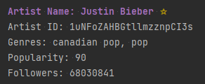
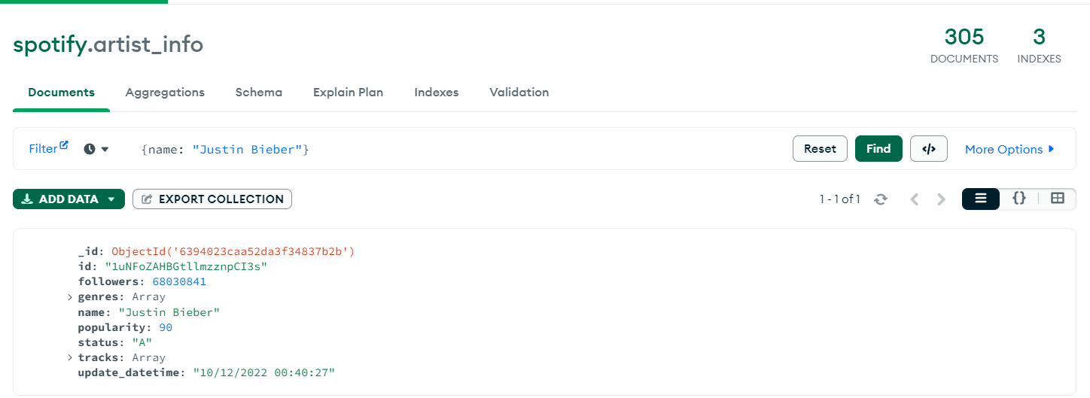
Deactivate/Activate Artists Profile (1/10)
User enters “4” as option and user enters Artist ID: “1uNFoZAHBGtllmzznpCI3s” to change the status from Active (A) to Inactive (I)
Current State before setting “Justin Bieber” to Inactive (I)

Slide 43
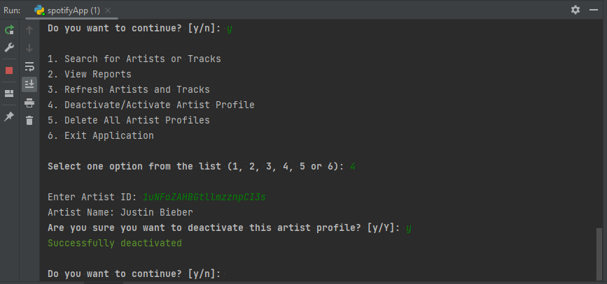
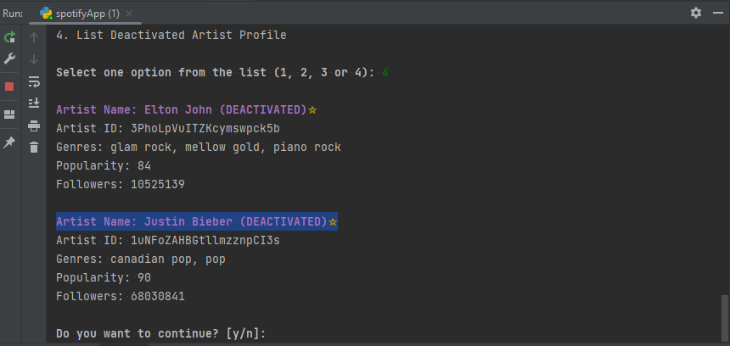
Deactivate/Activate Artists Profile (2/10)
Result after changing “Justin Bieber” status to Inactive. His name was added to the list of “Deactivated” artist profiles

Slide 44
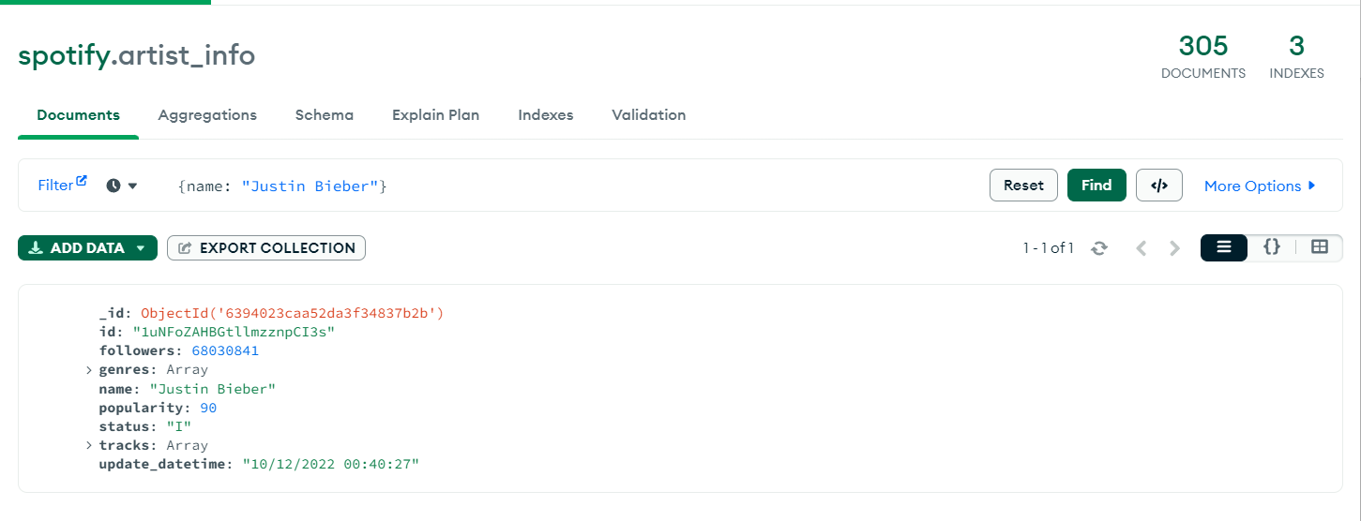
Deactivate/Activate Artists Profile (3/10)
Post Validation: The “status” was updated to “I” in MongoDB

Slide 45
Deactivate/Activate Artists Profile (4/10)
User enters “4” as option and user enters Artist ID: “1uNFoZAHBGtllmzznpCI3s” to change the status from Inactive (I) to Active (A)
For the current state before setting “Justin Bieber” back to Active, refer to the previous slide

Slide 46
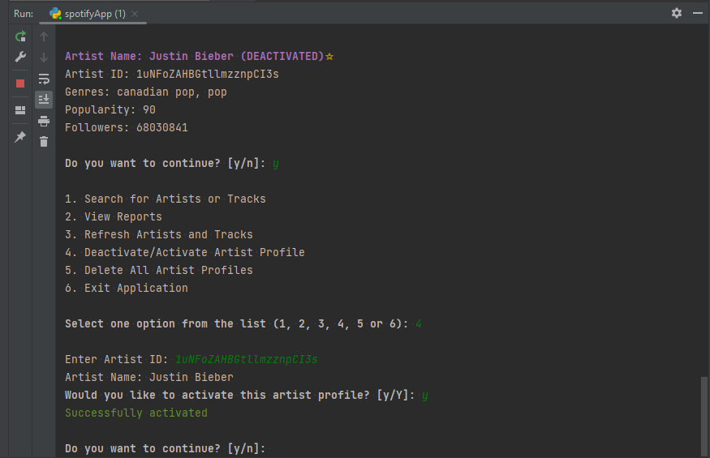
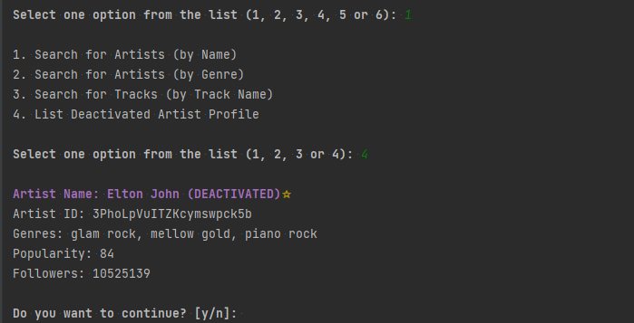
Deactivate/Activate Artists Profile (5/10)
Result after changing “Justin Bieber” status to Active. His name no longer included in the list of “Deactivated” artist profile.

Slide 47
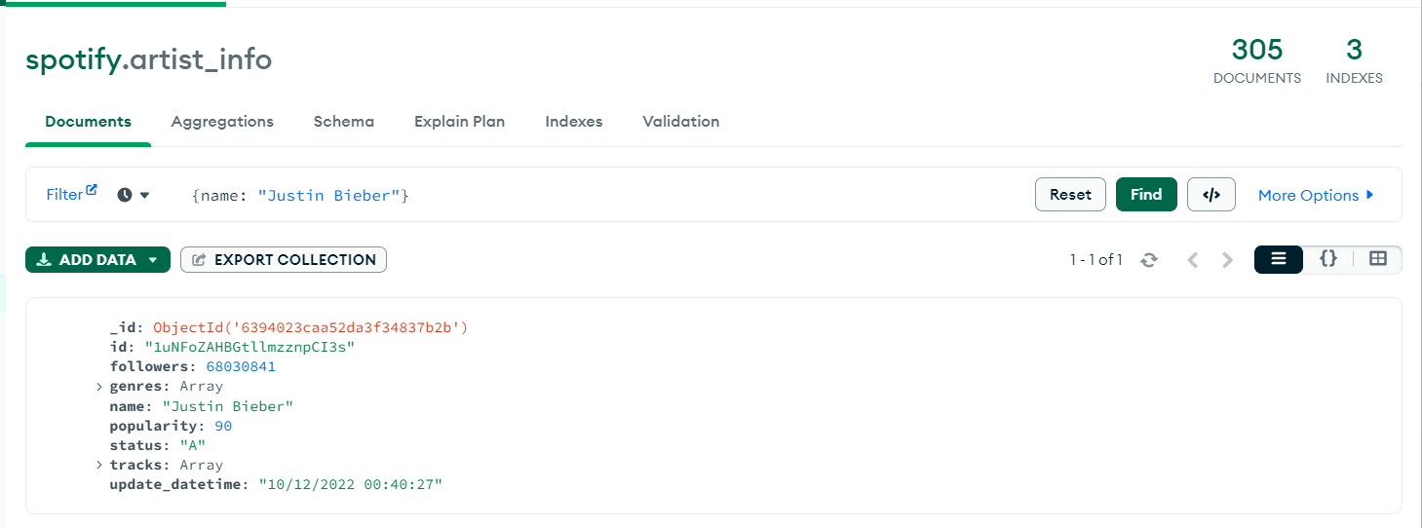
Deactivate/Activate Artists Profile (6/10)
Post Validation: The “status” was updated to “A” in MongoDB

Slide 48

Deactivate/Activate Artists Profile (7/10)

Slide 49



Deactivate/Activate Artists Profile (8/10)
Rules for Deactivated Artist Profile:
They are excluded when refreshing data from Spotify
Their name and tracks are excluded from all the reports

Slide 50


Deactivate/Activate Artists Profile (9/10)
“Taylor Swift” and her song “Anti-Hero” are excluded from “Top 10 Artists with Highest Popularity Index” and “Top 10 Tracks with Highest Popularity Index” reports respectively

Slide 51

Deactivate/Activate Artists Profile (10/10)

Slide 52
CONTENT
Project Overview
Spotify : MongoDB and PyMongo
Program Features
Search for Artists or Tracks
View Reports
Refresh Artists and Tracks
Deactivate/Activate Artists Profile
Delete All Artists Profiles
Exit Application

Slide 53


Delete All Artists Profiles (1/10)
User enters “5” as option to launch “Delete All Artist Profile”.
Note: Only Authorized Users are allowed to perform this procedure.
User enters valid credentials and asks if he would like to proceed with the deletion.

Slide 54

Delete All Artists Profiles (2/10)
User enters “n” and artist profiles will not be deleted from MongoDB

Slide 55


Delete All Artists Profiles (3/10)
Post Validation: Records of all artists still exist in MongoDB

Slide 56
Delete All Artists Profiles (4/10)
User enters “y” then “5” as option to launch “Delete All Artist Profile”. Note: Only Authorized Users are allowed to perform this transaction.
User enters valid credentials and user is asked if would like to proceed with the deletion.

Slide 57

Delete All Artists Profiles (5/10)
User enters “y” and all artists are deleted from MongoDB

Slide 58


Delete All Artists Profiles (6/10)
Post Validation: Records of all artists no longer exist in MongoDB

Slide 59


Delete All Artists Profiles (7/10)
Refresh data once again by getting fresh data from Spotify by running “Refresh Artists and Tracks”

Slide 60

Delete All Artists Profiles (8/10)
Post Validation: Compare time after refreshing data from Spotify

Slide 61


Delete All Artists Profiles (9/10)
Error Handling for Invalid Login Credentials. All documents in the collection will not be deleted from MongoDB.

Slide 62

Refresh Artist and Tracks and Delete All Artists Profiles (10/10)

Slide 63
CONTENT
Project Overview
Spotify : MongoDB and PyMongo
Program Features
Search for Artists or Tracks
View Reports
Refresh Artists and Tracks
Deactivate/Activate Artists Profile
Delete All Artists Profiles
Exit Application

Slide 64

Exit Application (1/1)
User enters “6” as option and user program exits successfully.

